Slide 1
Notes:
Although earlier attempts had been made to reform the Catholic church prior to the 16th century by men such as John Wycliffe and John Huss, Martin Luther is the most widely recognized person considered to have begun the Protestant Reformation movement that swept across Europe. By the time Luther came on the scene, the stage was set – the printing press was invented, the renaissance had taken hold, and the bible was available in languages other than Latin. Many were disenchanted with the Catholic church, its wickedness, its doctrine, and its hypocrisy. All people needed now were to men to lead the charge. They found this courage from Martin Luther, a Catholic priest who refused to sit on the sidelines.

Slide 2
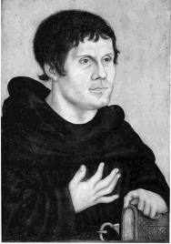
Martin Luther (1483 – 1546)
Well educated despite early poverty
In higher education, began a study of law
In 1505, entered the Augustinian monastery at Erfurt
In 1507, ordained a priest and assigned to Whittenburg, Germany
Luther thoroughly investigates bible
In 1512, was awarded a Doctor of Theology degree and began lecturing at the University
About this time, he was sent to Rome on a special mission and the corruption he saw helped crystallize his convictions
Others at the university, including professors, were becoming convinced of his doctrine of justification by faith alone
Notes:
Martin Luther was born in a poor family. Though his father, Hans, was a miner, he eventually gained wealth from copper mines of the areal. As a result, Luther was given a good education. Upon receiving his degrees in college, Luther decided to enter a monastery in Erfurt and was later ordained as a priest in 1507.
Under the admonition of Johann Von Staupitz, Luther began a rigorous study of the bible. Upon visiting Rome on business, Luther began to see the corruption of the Roman Catholic church and began realizing its need for reform. When transferred to Whittenburg in 1511 and continued his biblical studies while lecturing in bible theology. It was at this time that he began developing his doctrine of justification by faith alone. Others at the university, including professors, began to accept this view as well.

Slide 3
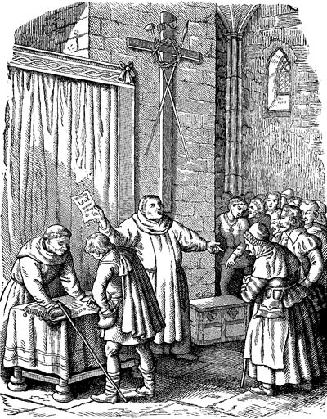
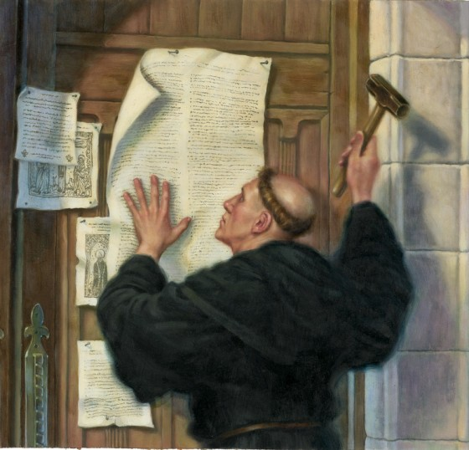
Luther Breaks w/Catholicism
John Tetzel came to Germany selling indulgences
Luther preached against it and on Oct 31, 1517, nailed his 95 theses to the church door of All-Saints church in Whittenburg
Luther’s motive was not to fight against the Catholic church, but to preserve its honor
Copies of the propositions spread all over Germany and Luther’s name became a household word
Notes:
In 1517, John Tetzel began selling indulgences in Germany and even went so far as to claim that repentance wasn’t necessary on the part of the buyer and that the indulgences gave complete forgiveness of sins.. Luther and others resented the exploitation of the people by these means, especially considering the proceeds from these particular indulgences were going to pay off bankers and to finish funding St. Peter’s cathedral. This was the straw that broke the camels back for Luther. On Oct 31, 1517, Luther posted his 95 Theses on the door of the Castle Church in Whittenburg. In them, he condemned the abuses of indulgences and challenged any who disagreed to debate him.
Luther’s purpose was not to destroy the Catholic church, but to reform it to what he believed the bible taught it should be. He soon found, however, that the Catholic church had gone too far down a path of perdition to be reformed and he was forced to eventually accept the fact that a true separation from Rome was required in order to truly reform the church. As a result of the printing press, copies of Luther’s theses spread all over Germany and Luther gained many sympathizers.

Slide 4
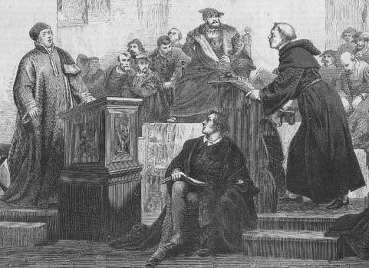
Luther Breaks w/Catholicism
John Eck brands Luther a heretic
Led to a 23 day debate between Luther and Eck designed to draw out Luther’s doctrines so the Pope would excommunicate him. He was successful
The Papal bull of condemnation was then issued against Luther
When it was delivered to Luther, he made a public display of burning it on the streets of Whittenburg. He was then excommunicated
Notes:
In July 1519, Luther debated with John Eck at Leipzig. Eck’s purpose was to draw Luther’s doctrines out so that the Pope would excommunicate him. Eck was successful in getting Luther to admit the fallibility of a general council, his unwillingness to accept the Pope’s decisions, and the validity of many of John Huss’s ideas.
In June 1520, Pope Leo X issued the papal bull “exsurge domine” which eventually led to Luther being excommunicated. Luther’s books were burned in Cologne. Not to be outdone, though, Luther retaliated by burning the pope’s bull publically on June 10, 1520. This led to his excommunication.

Slide 5
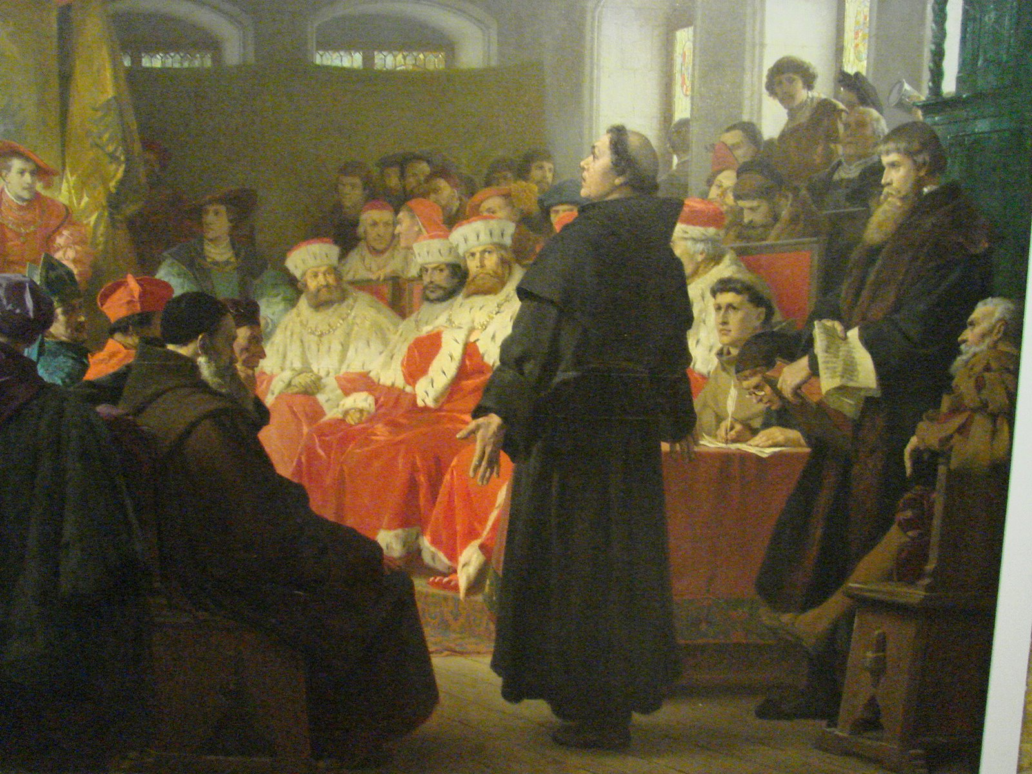
Luther Breaks w/Catholicism
1521 Appearance at the Diet of Worms
“Unless I shall be convinced by the testimonies of the Scriptures or by clear reason, …I neither can nor will make any retraction, since it is neither safe nor honorable to act against conscience; I can naught else! Here I stand! God help me!”
May 25, 1521, he was declared an outlaw
Returning to Whittenburg, his friends “kidnapped” him and he remained in Wartburg Castle ~1 year
During this time, he translated the NT into German
Notes:
Luther was summoned by the new emperor, Charles V, to appear at the diet of Worms to give an account of his views and teaching. He was promised protection by Frederick, who was the elector of Saxony and founder of Whittenburg University as well as other princes, and he received it. He refused to recant his views unless he could be convinced he was at fault from scripture itself. After his departure from Worms, the Diet issued an edict that ordered the seizure of Luther and to turn him over to authorities. The reading of his writings were also banned.
Fearing for his life, his friends and sympathizers kidnapped him on the road back to Wittenberg and took him to Wartburg Castle where he remained about a year. It was during this time that he translated the NT into German.

Slide 6
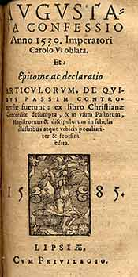
Lutheran Church
Outgrowth
People in sympathy w/Luther began meeting together
Gained momentum when Luther published two catechisms in 1529
In 1530, Philip Melanchthon published Augsburg Confession
formed doctrinal foundation of the Lutheran Church
Lutherans hold to the Apostles’, Nicene, and Athanasian Creeds
Notes:
Luther became a national hero to the Germans. Therefore people in sympathy with Luther began to meet together and form churches. Philip Melanchthon, an intelligent theologian and supporter of Luther and his views, published the Augsburg Confession – this became the official creed of the Lutheran church, but it was only the first of several published. Luther himself published two catechisms in 1529: the “Short Catechism” and the “Large Catechism”. This began a period of Protestant creedal development that saw even the so-called Apostles’, Nicene, and Athanasian creeds being used by the Lutheran church.

Slide 7
Lutheran Church
Facts about the Lutheran Church
Two sacraments: Baptism and the Eucharist
Baptism is “by washing, pouring, immersion, and sprinkling”
Infants born totally depraved; therefore must be baptized
The body and blood of Christ are “in, with and under the bread and wine of the Supper”
Direct operation of the Holy Spirit on the heart of the sinner; faith is “wholly and solely the gift and work of God”; salvation by faith alone
Notes:
The views Luther brought to the Lutheran church, while showing a withdrawal from Roman Catholicism, also showed that he could not depart from certain of its traditions. For example, Luther believed two of the seven Catholic sacraments were legitimate – baptism and the Eucharist.
Regarding baptism, Lutherans believe it can be by either sprinkling, pouring, washing, or immersion. Luther was a follower of Augustine (he used to be an Augustinian monk) and therefore accepted Augustine’s view on total hereditary depravity which led to the Lutherans’ practice of infant baptism.
Regarding the Eucharist, Lutherans believe that not only do partakers consume the elements of the Supper, but also the literal blood and body of Christ. To avoid confusion with Catholicism’s belief that it is only the body and blood of Christ and not the elements themselves, Luther termed it “consubstantiation”.
Luther also held to Augustine’s view that the Holy Spirit directly operates on the heart of the sinner and that a person cannot have true faith without that operation. In other words, to Luther, faith is “wholly and solely the gift and work of God”. This teaching was an outgrowth of his strict avoidance of any and all “works” involved in the salvation of man and also led to his belief in the doctrine of justification by faith alone.

Slide 8
Lutheran Church
Organization of the Lutheran Church
Locally – congregationally governed by a “church council” consisting of the “pastor” and elected “lay officers”
Synod is the next higher body, composed of “Pastors” and “lay representatives” elected by the congregations
Highest level of Lutheran government is the general body (national or international)
At one time, there were no fewer than 150 different Lutheran bodies in this country. Today that number has been reduced to less than 20
Notes:
Luther also adopted a pyramid organizational structure of the early Catholic church, but he avoided placing power in the hands of one man. Locally, the Lutheran churches are governed by a church council which, though consisting of the “Pastor”, also includes elected “lay officers”. Above the local congregation are synods composed of elected individuals by the congregations it rules, “Pastors” and “Lay Representatives”. The highest level of Lutheran government is the general body, which exists both national and internationally.
At one time, the Lutheran church was divided into no fewer than 150 different denominations but has been reduced today to about 20. Some Lutheran churches are more conservative than others, but all disagree on a plethora of issues and doctrine.

Slide 9
Luther’s Beliefs
“What is not contrary to Scripture is for Scripture and Scripture for it.” (Luther)
Simply stated, anything may be accepted which does not explicitly contradict the bible
What is wrong with this concept?
Notes:
Though Luther meant well and we admire him for exposing the errors of Catholicism with the courage that he did, we have disagreements with a variety of his conclusion, two of which we will discuss here.
First of all, Luther was of the opinion that “what is not contrary to Scripture is for Scripture and Scripture for it.” Simply stated, Luther believed that anything may be accepted which does not explicitly contradict the bible. This belief accounts for a wide variety of traditions that have been introduced into the Lutheran church as well as other denominations that have followed suit.

Slide 10
Silence Is Prohibitive
2 Sam 7:7 – “Wherever I have gone with all the sons of Israel, did I speak a word with one of the tribes of Israel, which I commanded to shepherd My people Israel, saying, ‘Why have you not built Me a house of cedar?’”
Lev 10:1 – “Now Nadab and Abihu, the sons of Aaron, took their respective firepans, and after putting fire in them, placed incense on it and offered strange fire before the Lord, which He had not commanded them.”
Jer 7:31 – “They have built the high places of Topheth, which is in the valley of the son of Hinnom, to burn their sons and their daughters in the fire, which I did not command, and it did not come into My mind.”

Slide 11
Silence Is Prohibitive
Deut 4:2 – “You shall not add to the word which I am commanding you, nor take away from it, that you may keep the commandments of the Lord your God which I command you.”
Prov 30:6 – “Do not add to His words or He will reprove you, and you will be proved a liar.”
Rev 22:18 – “I testify to everyone who hears the words of the prophecy of this book: if anyone adds to them, God will add to him the plagues which are written in this book.”
Notes:
God only had to say something once for it to be law. In regards to adding and taking away from scripture, he explicitly states it 3 times: in the beginning, middle, and end of the bible.

Slide 12
Silence Is Prohibitive
1 Cor 4:6 – “Now these things, brethren, I have figuratively applied to myself and Apollos for your sakes, so that in us you may learn not to exceed what is written, so that no one of you will become arrogant in behalf of one against the other.”
Heb 1:5 – “For to which of the angels did He ever say, ‘You are My Son, Today I have begotten You’?”
Heb 7:14 – “For it is evident that our Lord was descended from Judah, a tribe with reference to which Moses spoke nothing concerning priests.”

Slide 13
Luther’s Beliefs
Justification By Faith Only
An extreme invented to distance himself from the works based salvation of Catholicism
Historical example of attempting to avoid one extreme by running to the opposite extreme
What is wrong with this concept?

Slide 14
Grace, Faith, & Works
Jas 2:24 – “You see that a man is justified by works and not by faith alone.”
Works that don’t save are:
Works of merit
Eph 2:8-9 – “⁸For by grace you have been saved through faith; and that not of yourselves, it is the gift of God; ⁹not as a result of works, so that no one may boast.”
Tit 3:5 – “He saved us, not on the basis of deeds which we have done in righteousness, but according to His mercy, by the washing of regeneration and renewing by the Holy Spirit”
Works of the law
Rom 3:28 – “For we maintain that a man is justified by faith apart from works of the Law.”
Acts 13:39 – “And through Him everyone who believes is freed from all things, from which you could not be freed through the Law of Moses.”
Notes:
Luther was so disgusted with James’ teaching on works that he claimed it was an “epistle of straw” and wanted it removed from the canon.

Slide 15
Grace, Faith, & Works
Works that do save are:
Works of God
John 6:28-29 – “²⁸Therefore they said to Him, ‘What shall we do, so that we may work the works of God?’ ²⁹Jesus answered and said to them, ‘This is the work of God, that you believe in Him whom He has sent.’”
2 Cor 7:10 – “For godly sorrow worketh repentance unto salvation, a repentance which bringeth no regret: but the sorrow of the world worketh death.”
Col 2:12 – “having been buried with Him in baptism, in which you were also raised up with Him through faith in the working of God, who raised Him from the dead.”
Rev 2:26 – “And he that overcometh, and he that keepeth my works unto the end, to him will I give authority over the nations”

